Slide 1
Creating a Strong Teaching Philosophy and Research Narrative
Javier Cavazos Vela and Claudia Vela
Center for Teaching Excellence (CTE)

Slide 2
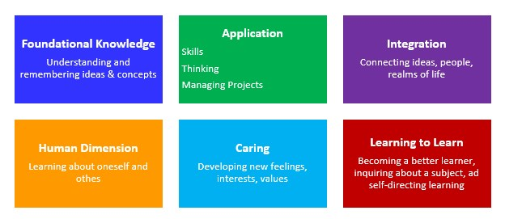
Learning Objectives
After this interactive workshop, you will be able to:
Recognize potential key areas of a statement of teaching philosophy
Identify potential structure for a statement of teaching philosophy
Evaluate a statement of teaching philosophy
Create a plan to improve your teaching and research philosophies

Slide 3
Focus Activity
Take 5-minutes to reflect and respond to questions on the following handout, Statement of Teaching Philosophy: Potential Important Areas to Consider
When you are done, turn to your neighbor and
take 4-minutes to share your responses.

Slide 4
What is a Statement of Teaching Philosophy?
A statement of teaching philosophy is a clear and concise narrative that answers the following direct question:
What does teaching and learning mean to you?
Hegarty (2005) stated that a statement of teaching philosophy “is the mission statement of a faculty member which declares where they would like their teaching to go and in doing so helps to keep faculty motivated and committed to constant improvement.”

Slide 5
Potential Key Areas
Ideas or theories toward teaching and learning
Personal views toward teaching
Teaching strategies
Learning environment
Student learning objectives
Assessment activities
Professional development activities

Slide 6
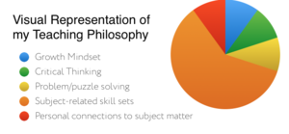
Teaching Philosophy Structure
Between one and two pages long; single-spaced; and 11 or 12-point font
A personal narrative
Evidence of personal beliefs and values
Representative of experience and practice
Showcase for strengths
Place that points to directions toward future growth
Effective abstract for a teaching portfolio

Slide 8
Focus Activity
The purpose of this activity is to evaluate a statement of teaching philosophy. Evaluate your neighbor’s statement of teaching philosophy using our rubric.
Take 8-minutes to evaluate and make sure
to provide feedback to make improvements

Slide 9
Reflection
What areas of your partner’s statement of teaching philosophy are strong?
What areas could use improvement?
What needs to be done to improve these areas?
What do you think about the potential areas to include in a statement of teaching philosophy?
Are there some that you would not include or others that you would include?

Slide 10
Research Narrative
What is the impact, quality, intentionality, and significance of your scholarship?

Slide 11
Research Narrative
Impact
Grant funding, citation metrics, journal acceptance ratings, impact factors, collaboration with students and colleagues
Intentionality
Research focus
Connections among research, teaching, and service
Write and collaborate with intent
Submission to specific peer-reviewed journals or funding agencies

Slide 12
Research Narrative
Significance
Fill gaps in the literature
Implications that influence practice or policy
Provide students with research experiences
Grant funding

Slide 13
Final Remarks
Thank you for participating in this interactive workshop where we hope you met session objectives and developed a plan to improve your teaching or research philosophies.
Please complete evaluation questions about your learning experiences and level of satisfaction.
Please also take a look at “resources” on our website “utrgv.edu/cte” which will provide helpful and additional information.

Slide 14
References and Helpful Resources
Axelrod, R. B., & Cooper, C. R. (1993). Reading critically, writing well: A reader and guide (3rd ed.). New York, NY: St. Martin’s.
Chism, N. V. (1998). Developing a philosophy of teaching statement. Essays on Teaching Excellence, 9, 1-2. Professional and Organizational Development Network in Higher Education.
Coppola, B. P. (2002). Writing a statement of teaching philosophy: Fashioning a framework for your classroom. Journal of College Science Teaching, 31, 448.
Goodyear, G. E., & Allchin, D. (1998). Statement of teaching philosophy. In M. Kaplan (Ed.), To improve the academy (pp. 103-122). Stillwater, OK: New Forums Press.
Hegarty, N. (2015). The growing importance of teaching philosophy statements and what they mean for the future: Why teaching philosophy statements will affect you. Journal of Adult Education, 44, 28.

Slide 15
References and Helpful Resources
Kaplan, M., O’Neal, C., Meizlish, D., Carillo, R. & Kardia, D. (n.d.). Rubric for Statements of Teaching Philosophy.
Kearns, K. D. and Sullivan, C. S. (2011). Resources and practices to help graduate students and postdoctoral fellows write statements of teaching philosophy. Advances in Physiology Education, 35, 136-145.
Landrum, R. E., & Clump, M. A. (2004). Departmental search committees and the evaluation of faculty applicants. Teaching of Psychology, 31, 12-17.
Schönwetter, D. J., Sokal, L., Friesen, M., & Taylor, K.L. (2002). Teaching philosophies reconsidered: A conceptual model for the development and evaluation of teaching philosophy statements. International Journal of Academic Development, 7, 83-97.
The University of Texas at Austin Faculty Innovation Center (2017). Teaching statement. Retrieved from https://facultyinnovate.utexas.edu/opportunities/prof-dev/statement
Weimer, M. (2011). Writing better teaching philosophy statements. The Teaching Professor, 25, 6.

